Slide 1
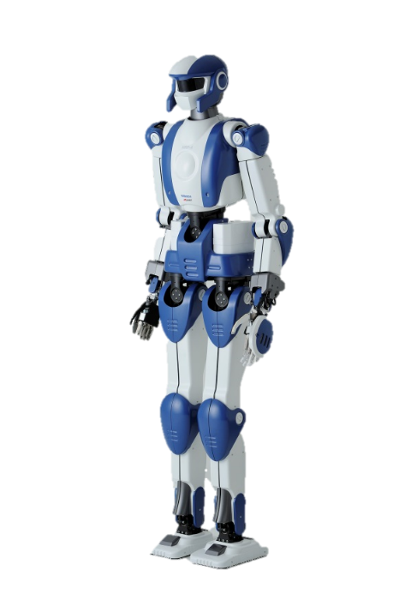
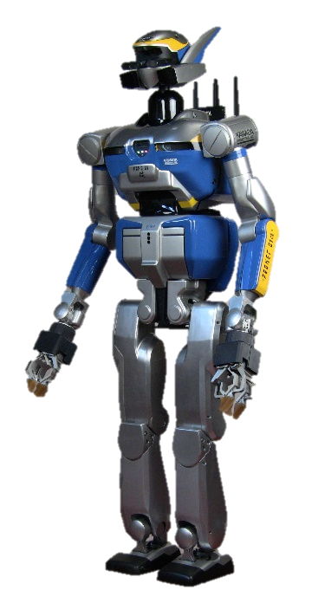
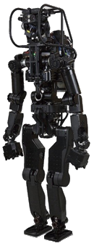
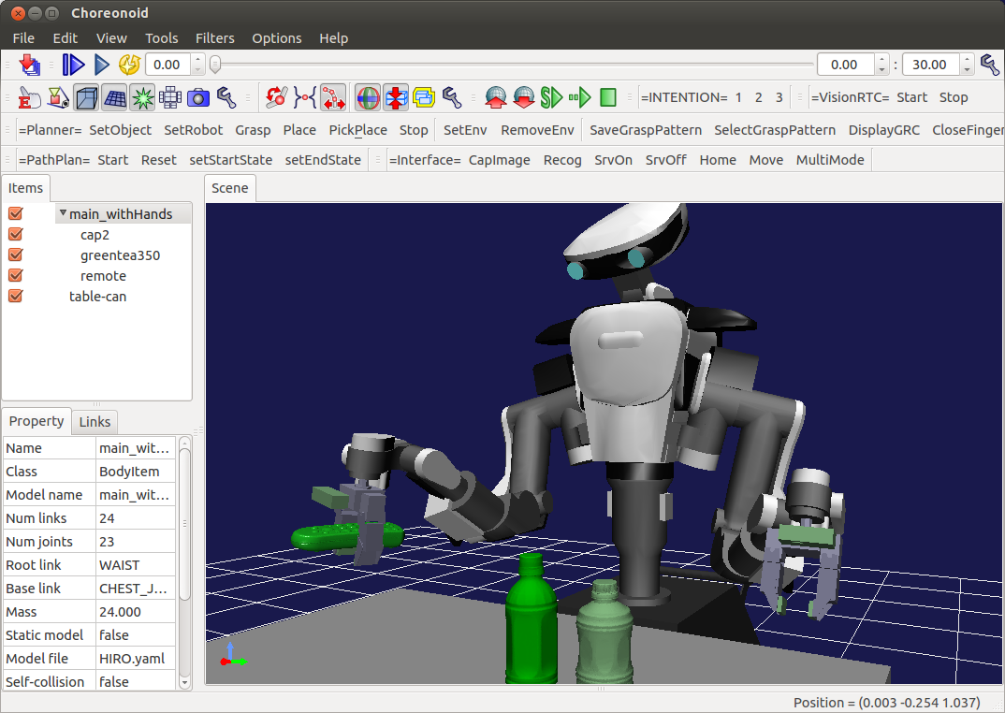
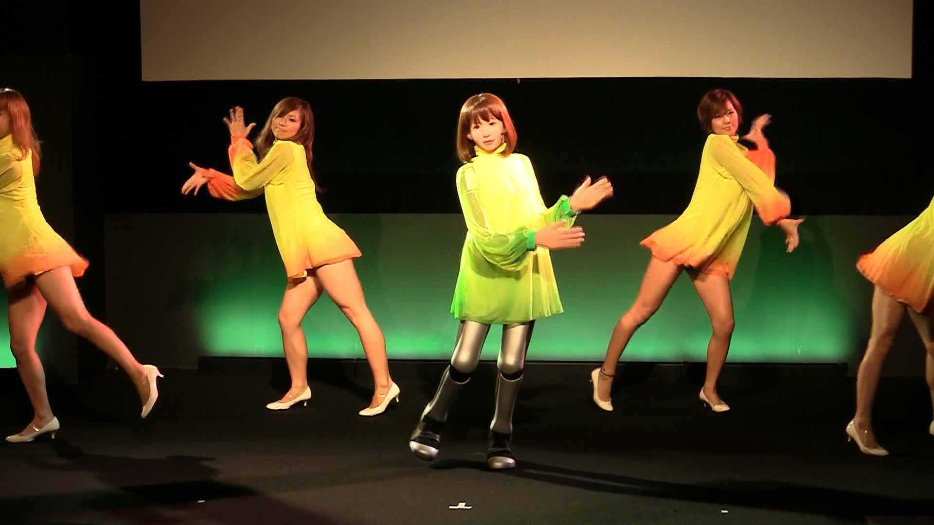
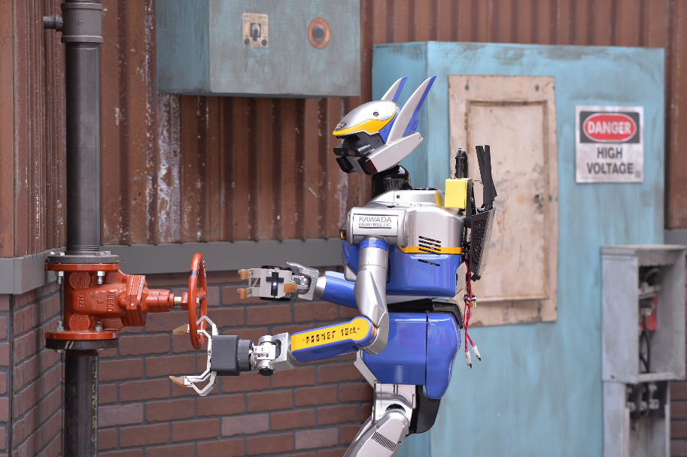

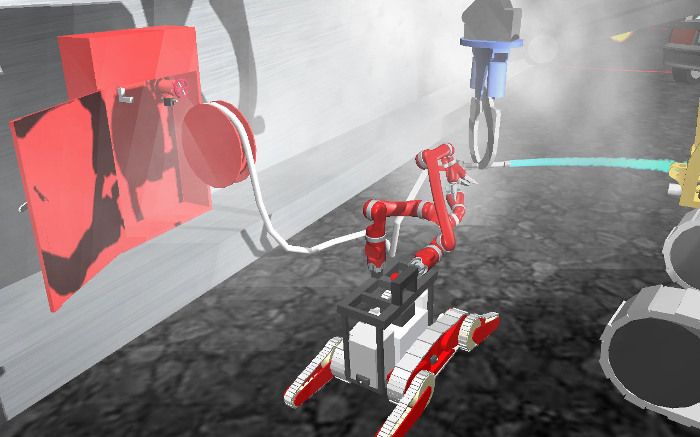
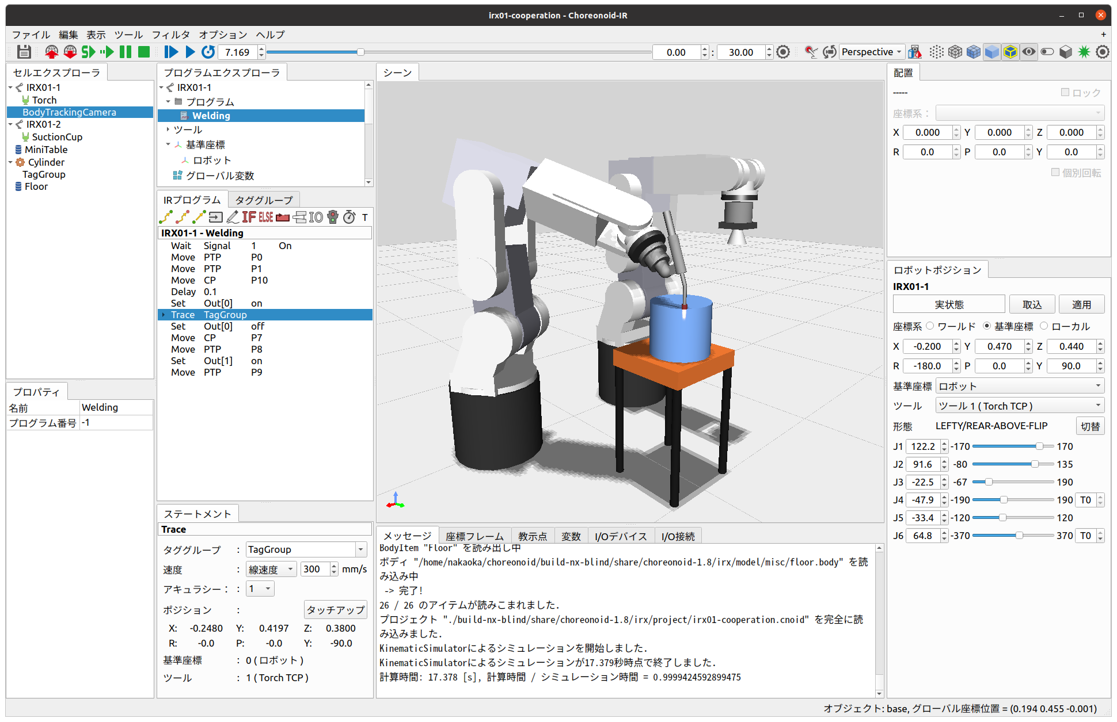
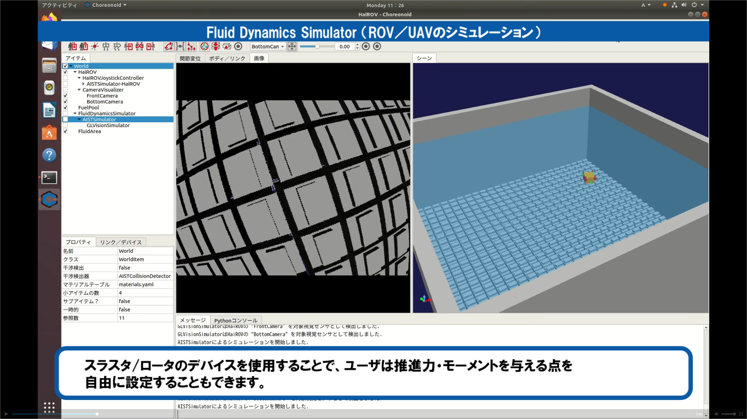
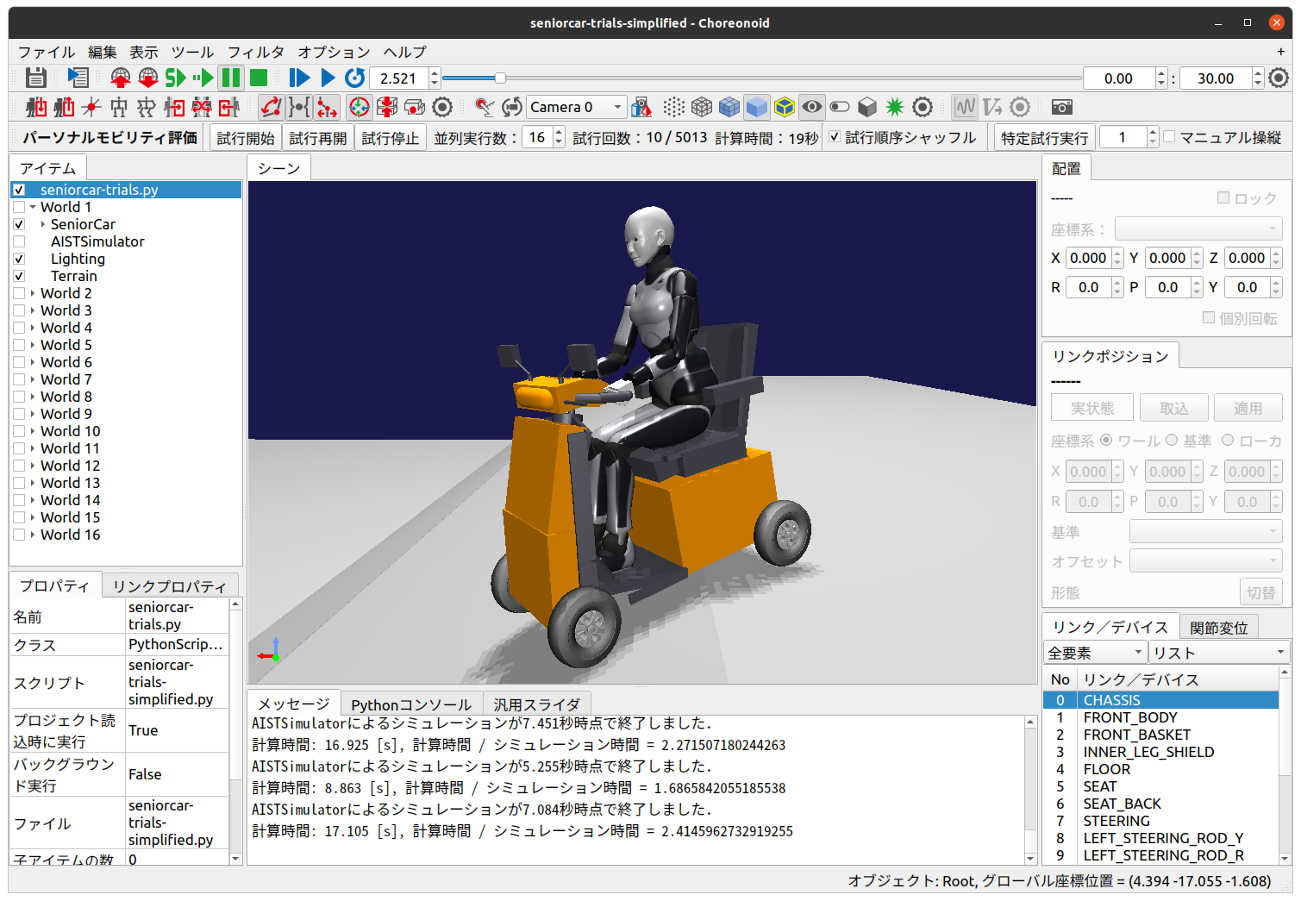
Applications of Choreonoid
©AIST
graspPlugin
©AIST
DC-EXPO 2010
©AIST
DRC Finals
©DARPA
Development of HRP-series Humanoid Robots
Motion Planning for Industrial Manipulators
Dancing a Humanoid Robot
Integrating Tele-operated Semi-autonomous Systems
World Robot Summit
HAIROWorldPlugin
©JAEA
©The Univ. of Tokyo
Robot Simulation in Disaster Response
Teaching Industrial Robots with Graphic User Interfaces
Virtual Tele-operation Environment for Nuclear Decommissioning
Risk Assessment of Assistive Products

